Slide 1

Second-hand Luxury Market Analysis
Vestiaire Collective

Slide 2

Vestiaire Collective
Vestiaire Collective is a global platform for buying and selling pre-owned luxury and designer fashion.
Revenue Streams: Commission-Based Model (once sold, the platform deducts a commission (e.g., 10%-40%) before paying the seller.)
Market Capacity: The global secondhand luxury market value stood at US$34.39 billion in 2023, and is expected to reach US$60.55 billion by 2029.
Problems:$0.84 billion GMV in 2023, significantly lower than the competitor’s $1.83 billion; low conversion rate per listing
Notes:
This dataset contains product listings from Vestiaire(ves-tee-air), an online marketplace for buying and selling pre-owned luxury fashion items. It was scraped using Python and the Hrequests Library. The CSV file contains approximately 900k rows and 36 columns.
Containing both listing attributes and performance metrics (sold status, likes), it enables us to move beyond descriptive statistics to causal analysis of what drives conversion in luxury markets,
First, it provides rich, multi-dimensional data across geographic markets, brand categories, price points, and product types - creating ideal conditions for segmentation analysis and predictive modeling relevant to our course objectives.

Slide 3

Transaction rate
A manifesto for agile data science
Action
Strategy & Recommendation
Prediction
ML & Causal Inference
Reports
Market Segmentation
Charts
Clean, Aggregate, Visualize
Records
Collet dataset: Kaggle

Slide 4
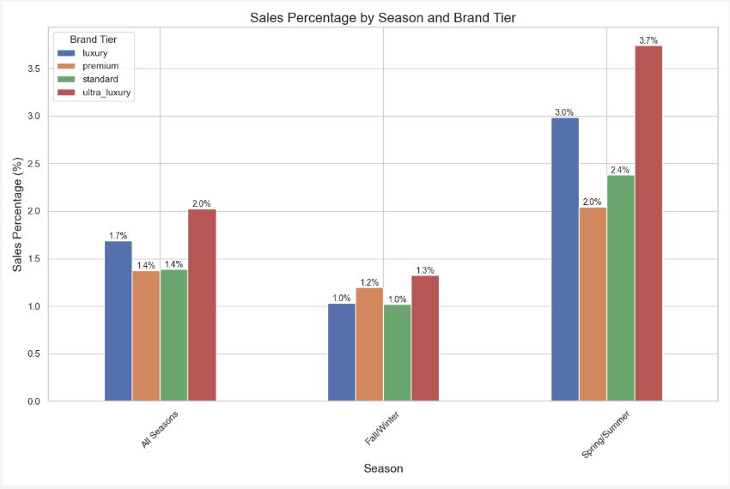
Market Segmentation:
1. Sales Percentage by Season and
Brand Tier
Spring/Summer is the peak selling season for all brand categories, with ultra-luxury brands achieving the highest conversion rates (~3.7% ).
Ultra-luxury brands consistently outperform premium brands, highlighting the need for distinct promotional strategies and informing inventory and marketing planning.
Notes:
This bar chart visualizes how sales conversion rates vary across different seasons (Spring/Summer, Fall/Winter, All Seasons) for each brand tier (Ultra-Luxury, Luxury, Premium, Standard). The methodology involves calculating the percentage of listed items that were successfully sold, grouped by season and brand tier.
Key business insights: Ultra-luxury brands show the highest conversion rates (approximately 3.7%) during Spring/Summer season, suggesting seasonal shopping preferences for high-end items. The consistent pattern across all brand tiers shows Spring/Summer as the strongest selling season. This seasonality insight is crucial for inventory planning and marketing campaign timing, allowing businesses to optimize their product offerings during these peak periods. The significant gap in conversion rates between ultra-luxury and premium brands demonstrates the stronger market position of exclusive brands regardless of season.
Looking at the code in the SeasonalLuxuryDemandAnalyzer class, these percentages are calculated in the analyze_seasonal_demand() method. The calculation flows as:
Data is grouped by season_standardized and brand_tier columns
For each group, the code calculates 'sold': ['count', 'sum', 'mean']
The sold_mean is the key metric here - since 'sold' is a binary column (0/1), taking the mean effectively calculates the percentage of items sold
In _plot_sales_percentage(), this mean is multiplied by 100 to show as a percentage:

Slide 5
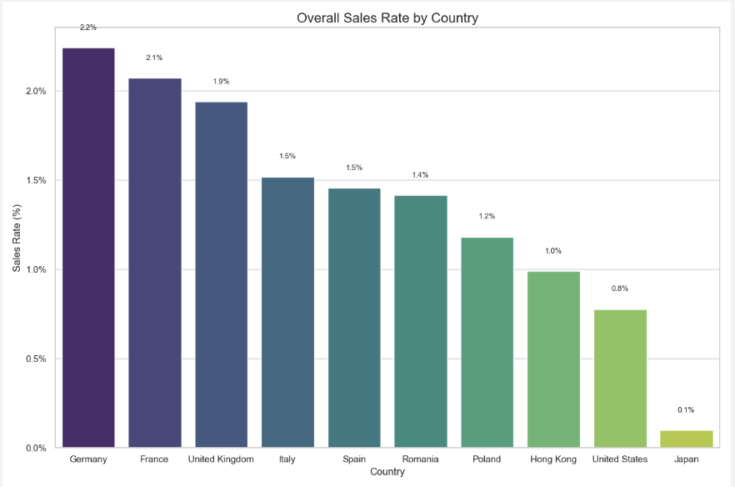
Market Segmentation:
2. Country Sales Rates Comparison
(Bar Chart)
European markets, such as Germany (2.24%) and France (2.07%), have significantly higher conversion rates than Japan (0.10%).
These disparities highlight market traction differences and inform resource allocation for strategic growth.
Notes:
This bar chart provides a clear comparison of overall sales conversion rates across different countries. The methodology calculates the percentage of all listed items that successfully sold in each country, arranged in descending order. Germany shows the highest overall conversion rate at approximately 2.24%, while Japan shows the lowest at just 0.10%.
These insights are critical for market prioritization and expansion strategies. The substantial performance gap between European markets (France, Germany, UK) and Asian markets (Japan, Hong Kong) suggests potentially different marketplace adoption rates or competitive dynamics. For business operations, this data helps prioritize customer service resources, marketing spend, and potential market expansion efforts. The underperforming markets might require different approaches, such as more localized features, different authentication processes, or targeted promotions to drive better conversion. This visualization provides a clear roadmap for geographic market development priorities.
The calculation specifically:
Counts all items where seller_country = specific country AND sold = 1
Divides by total count of items where seller_country = specific country
Multiplies by 100 to convert to percentage
The _plot_sales_rates_by_country() method then extracts these calculated rates, sorts them in descending order, and creates the bar chart. This provides a direct comparison of marketplace performance across different geographic markets.

Slide 6
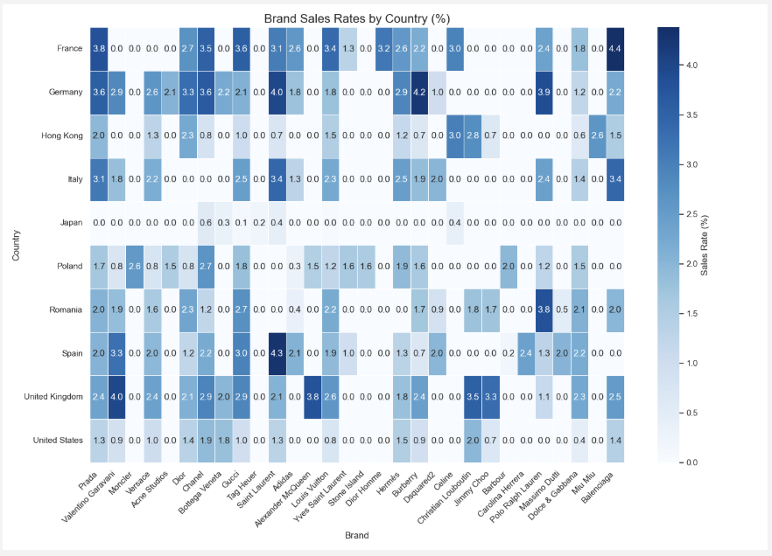
Market Segmentation:
3. Brand Sales Rates by Country
(Heatmap)
Luxury brand performance varies by region, with Balenciaga excelling in France (4.38%) and Christian Louboutin resonating in the U.S. (1.98%).
These cultural differences emphasize the need for localized marketing and geographic segmentation in merchandising and promotions.
Notes:
This heatmap visualizes how different luxury brands perform across various countries, with color intensity representing sales conversion percentages. The methodology involves calculating sales rates for each brand-country combination and presenting only the top-performing brands for clarity. The analysis reveals distinct brand preferences across geographic markets.
The business implications are significant for international marketing strategy. Brands like Balenciaga showing strong performance in France (4.38%) while Christian Louboutin(loo-boo-tahn) performs well in the United States (1.98%) demonstrates how brand resonance varies by cultural context. For marketplace platforms, this data supports country-specific featured collections and targeted marketing. For brands, it identifies both stronghold markets to maintain and underperforming markets that might benefit from increased marketing investment or localized approaches. The considerable variation across countries highlights the importance of geographic segmentation in luxury retail strategy.
For each country-brand combination:
listings counts the total number of items
sales sums the sold column (which contains 0s and 1s)
sales_rate calculates (sales/listings)*100, with a zero-division safeguard
The _plot_brand_heatmap() method then creates a pivot table:
This places countries as rows and brands as columns, with sales rates as the values, effectively creating a matrix of conversion performance that gets visualized as a heatmap.

Slide 7
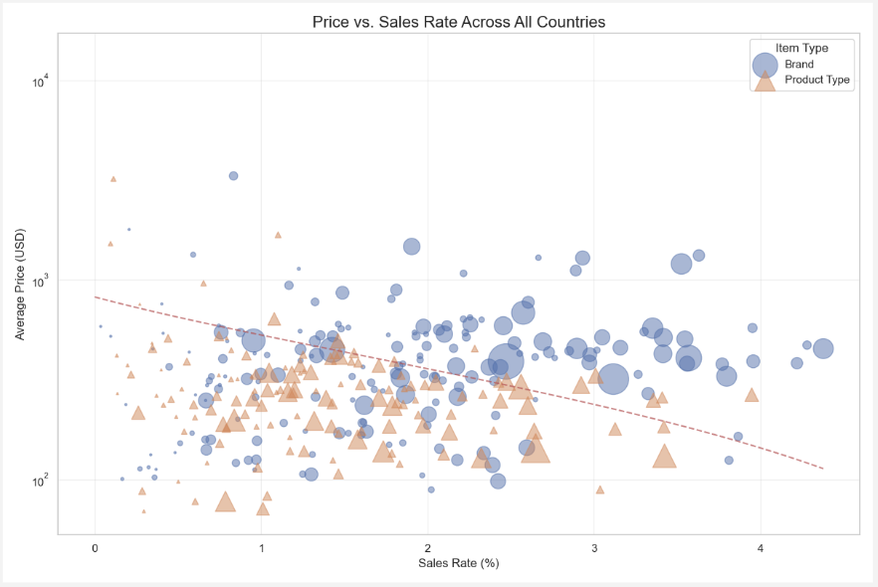
Market Segmentation:
4. Price vs Sales Rate Scatter Plot
﻿﻿Higher prices do not necessarily lower conversion rates in luxury markets, with some ultra-luxury brands seeing higher conversion despite premium pricing.
﻿﻿This insight highlights exclusivity as a key driver of demand, reshaping pricing strategies to optimize conversion and revenue.
Notes:
This visualization plots the relationship between average price and sales conversion rate across all country-brand and country-product combinations. The methodology uses different markers to distinguish between brands and product types, with point size representing sales volume. A logarithmic trendline indicates the overall relationship between price and conversion.
The business insights from this chart address the fundamental price-conversion relationship in luxury markets. Contrary to general retail wisdom, the data likely shows that higher prices don't necessarily lead to lower conversion rates in the luxury segment - in fact, certain ultra-luxury brands may show higher conversion despite premium pricing. This counterintuitive relationship demonstrates the unique value dynamics in luxury markets where prestige and exclusivity can drive demand. For pricing strategy, this visualization helps identify optimal price points that maximize both conversion and revenue, while also highlighting outliers that demonstrate exceptional value perception or brand strength. The distinction between product categories and brands helps understand where category dynamics versus brand equity drives purchasing behavior.
The scatter plot uses:
sales_rate (x-axis) - calculated as (sales/listings)*100
avg_price (y-axis) - calculated as the mean price using brand_data['price_usd'].mean()
Point size - scaled by number of sales using s=group['sales'] * 5
Different markers - circles for brands, triangles for product types
The plot also includes a logarithmic trendline to visualize the relationship between price and conversion rate:

Slide 8

Buyer Segmentation
02

Slide 9
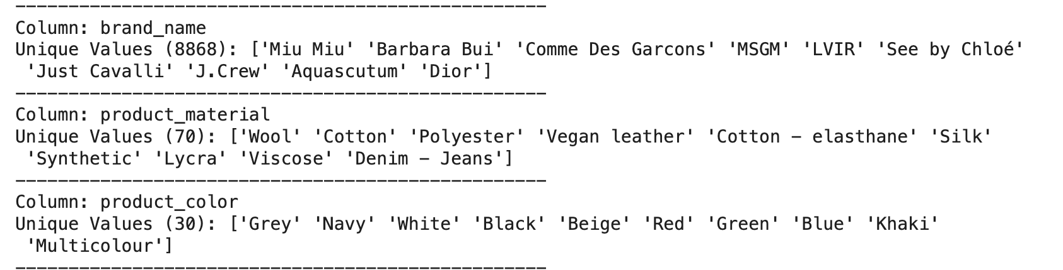
Product(Sold) Segmentation
Data pre-processing
Feature Engineering
EDA
Handle missing value
Feature selection (only product related info & correlation matrix)
Standardization /Normalization
One-Hot Encoding
Create brands representative column with average price
Frequency representation of materials and color
Clustering Algorithm
Evaluation/Fine tuning
Visualization & Interpretation
K-Means
DBSCAN
Gaussian Mixture Model
Elbow Methods
Silhouette Score
PCA/t-SNE - Cluster visualization
Semi-supervised learning: Decision tree

Slide 10
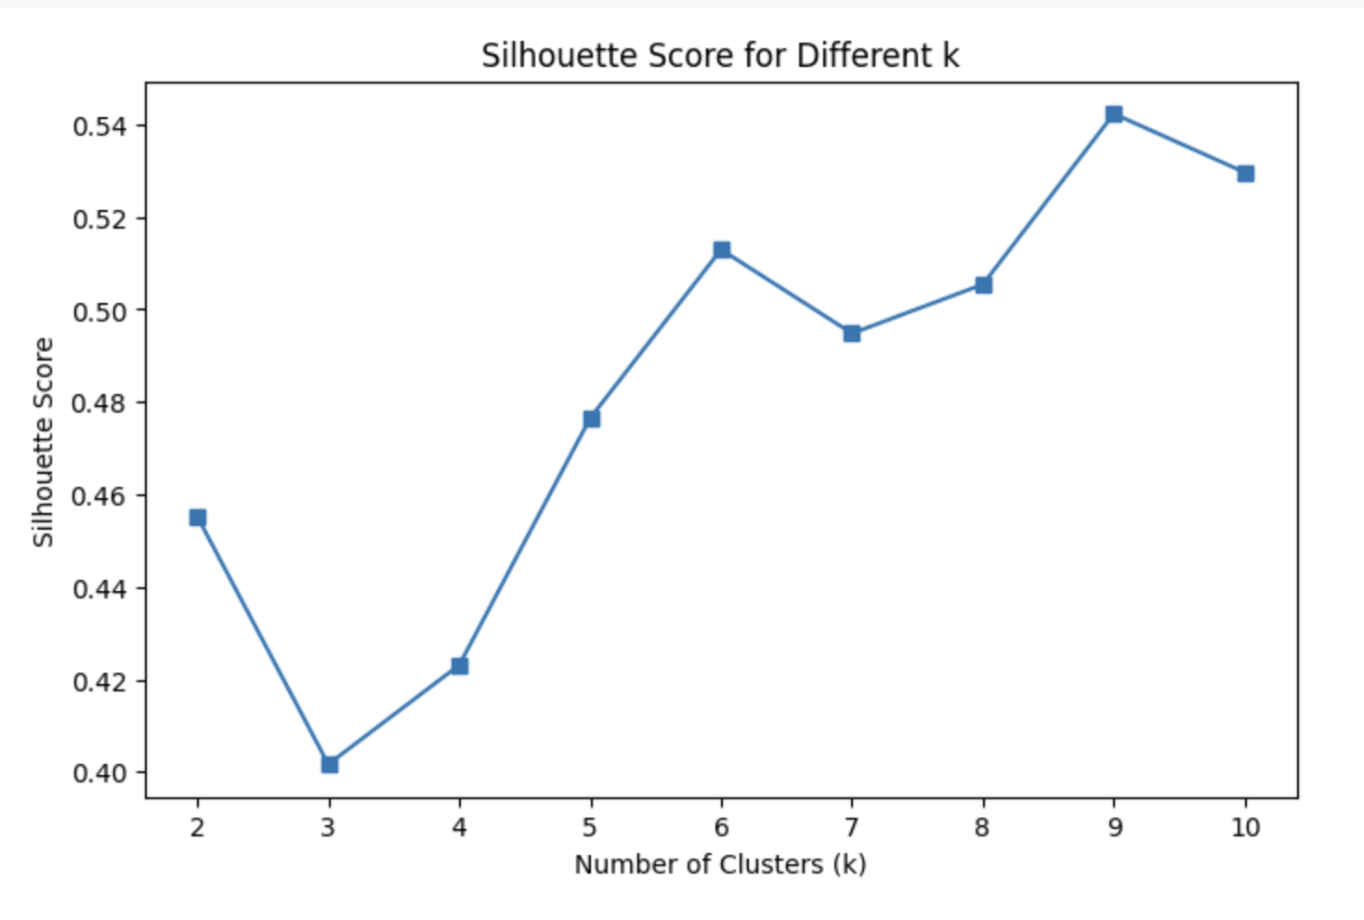
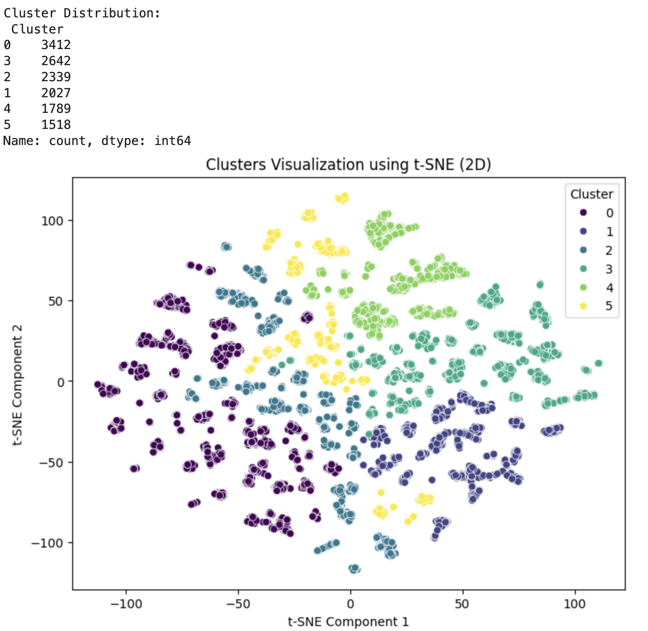
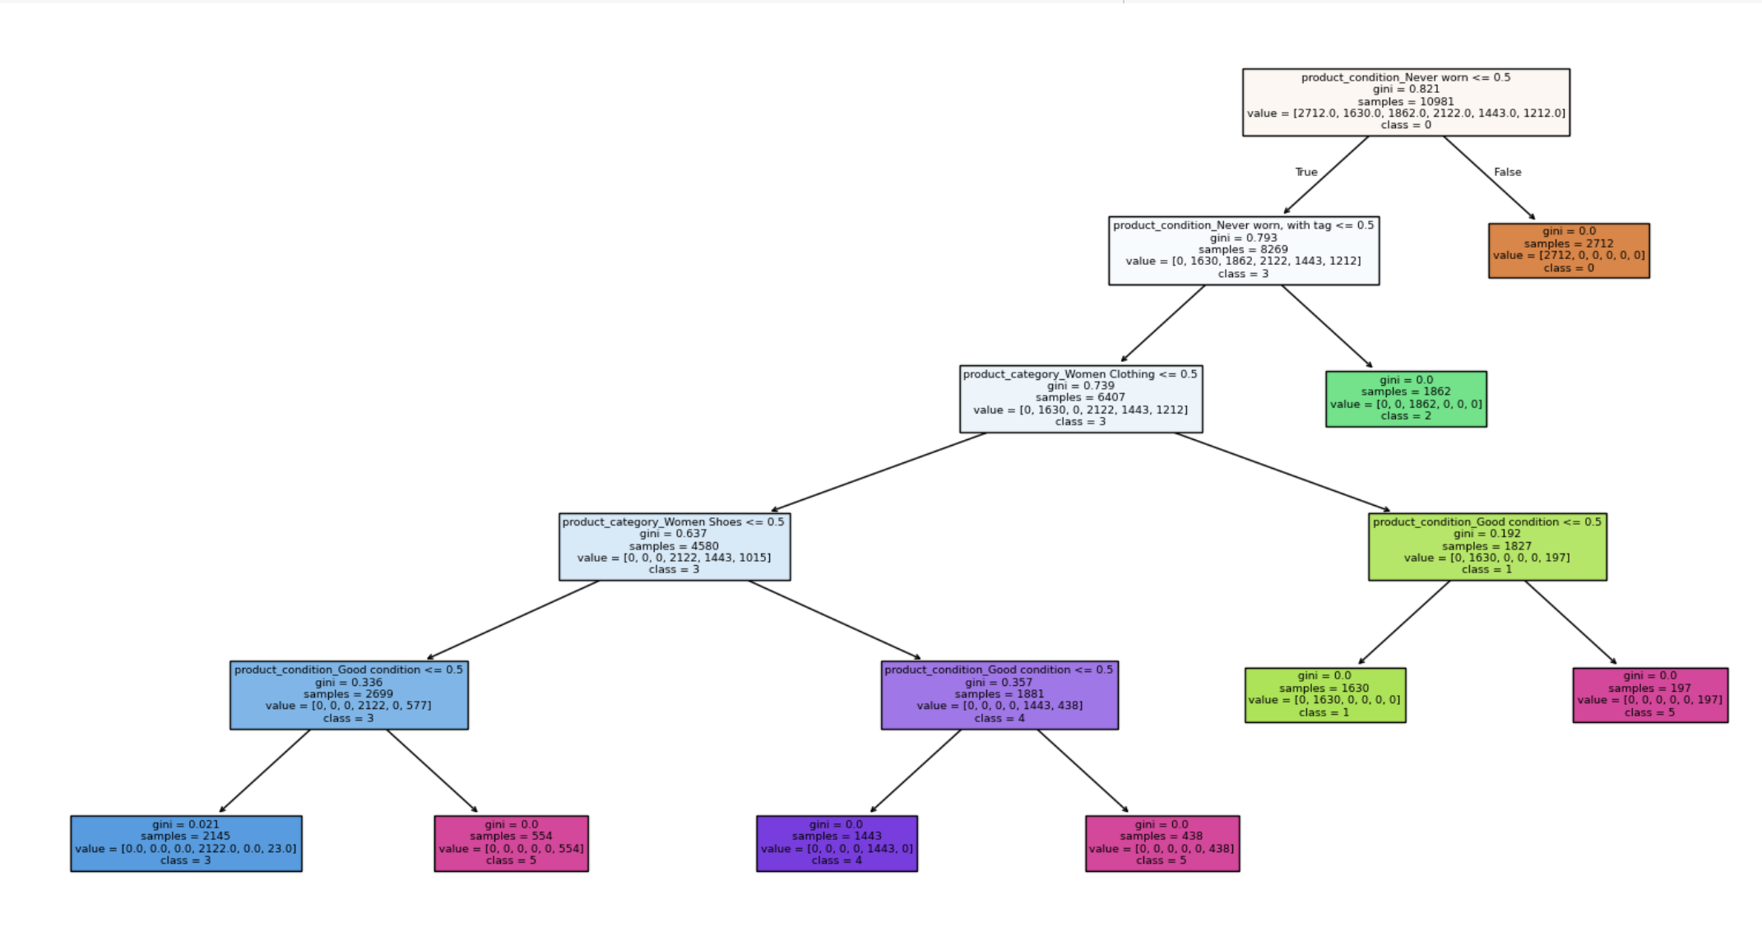
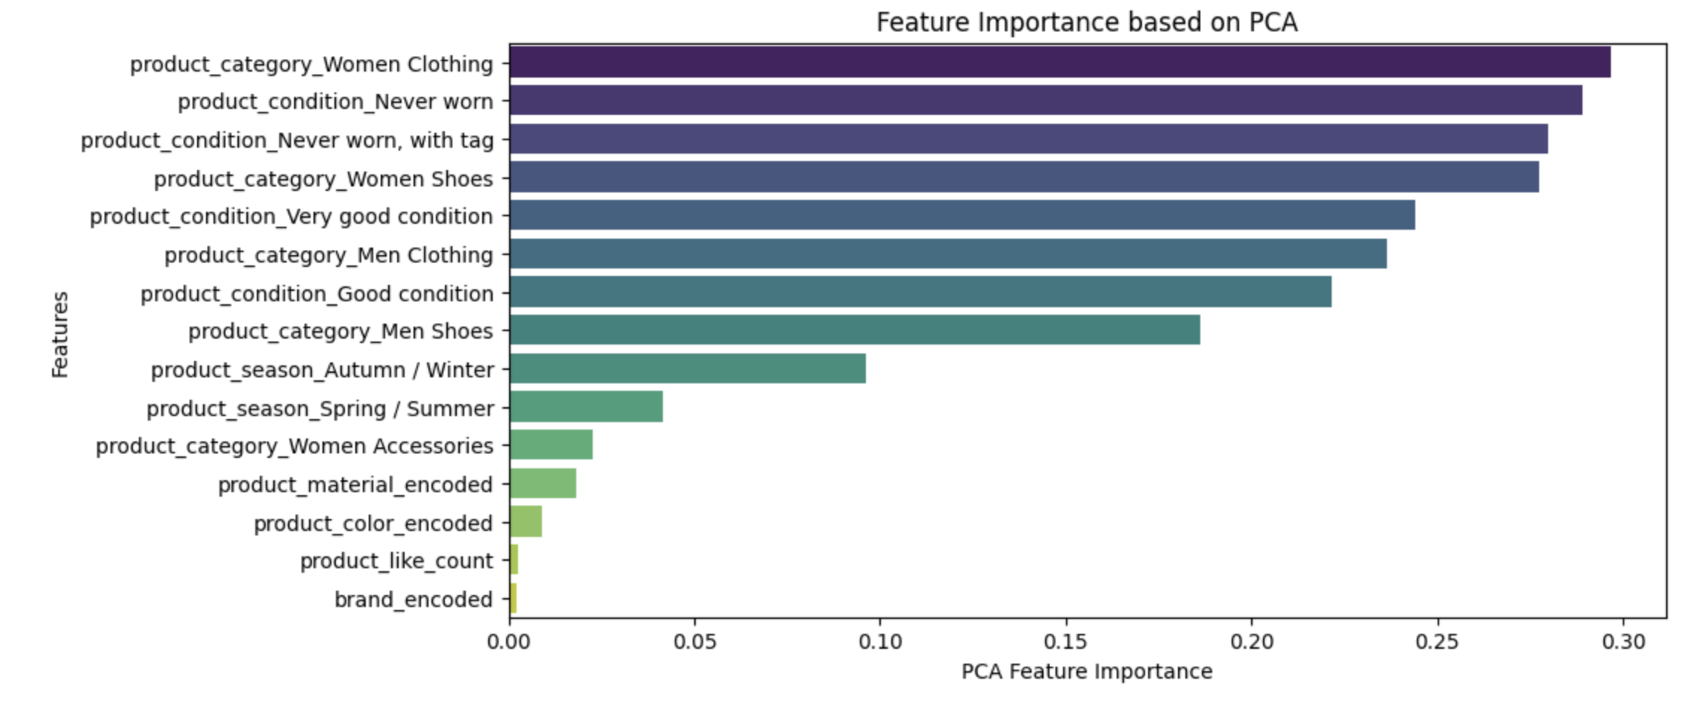
Cluster Results & Insights:
Silhouette score: 0.53
6 Clusters
Decision Tree
Feature importance
Cluster | Buyer Profile | Key Preferences | Strategy
0 & 2 - Quality Buyers | High-end shoppers | Only buy "Never Worn" or "With Tags" items, focus on authenticity & resale value | Offer premium authentication & certified resale options
1 & 5 - Budget Buyers | Price-sensitive or exploring luxury | Prefer "Good Condition", accessories, shoes, and entry-level luxury | Highlight discounts, first-time deals & smart savings sections
3 & 4 - Fashion & Seasonal Buyers | Trend-conscious & occasional shoppers | Focus on Women’s & Men’s Clothing, buy based on seasonality & trends | Promote seasonal collections, influencer styles & gifting ideas

Slide 11
Price Elasticity and Analysis on Sold Items
03

Slide 12
Price Elasticity Analysis
Price Elasticity measures how demand changes in response to price changes. Typically, demand decreases when price increases (elastic), or remains stable (inelastic).
However, for Veblen goods (luxury/status-driven) and Giffen goods (essential but consumed more when prices rise), demand may increase with price.

Slide 13
Analysis Steps
Missing Values
Collinearity Checks
Feature importance
Uneven Distribution of Target Variable
Model training + Learning Curve
Causal Analysis - Price Elasticity
Handled missing values with appropriate imputation (eg: extracting color names from product_description using a predefined list and a regex pattern to match standalone color)
Used VIF Scores and Collinearity Matrix to eliminate variables.
Used XGBRegressor to further filter out important features for training.
Used SMOTomek to balance the dataset and improve model generalization.
Trained three models — XGBoost, LightGBM, and CatBoost — to predict product demand and evaluated their performance using the ROC-AUC score and learning curves.
Examined price elasticity by assessing demand shifts in response to price changes, identifying features that significantly impact purchasing behavior.

Slide 14
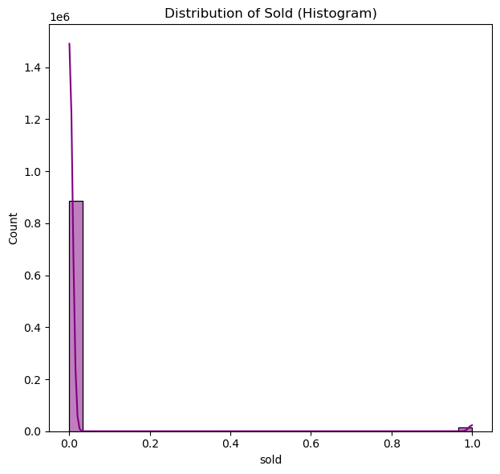
As seen in this figure,
The distribution of the target was extremely skewed, so using sampling techniques like SMOTETOMEK was a necessity.

Slide 15
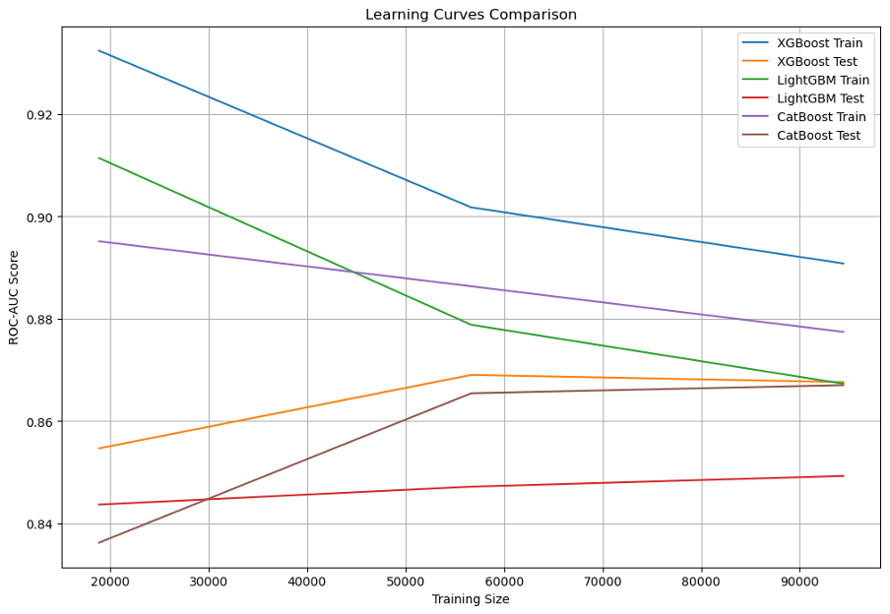
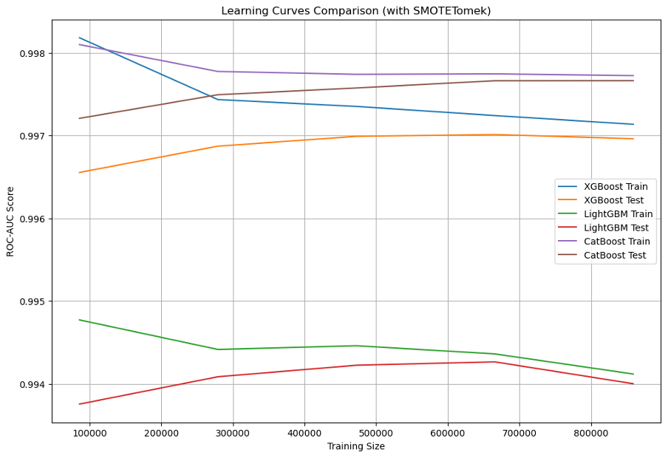
Training + Learning Curves
WITHOUT Smottomek
WITH Smottomek
XGBoost shows the highest training and testing performance but exhibits a clear gap between training and testing curves, indicating overfitting.
LightGBM and CatBoost have lower ROC-AUC scores, with LightGBM performing better on both train and test sets.
There is a downward trend in training performance as the sample size increases, which is expected due to increased complexity in larger datasets.
The overall ROC-AUC scores for all three models improve significantly across both training and testing sets.
The gap between the training and test curves is reduced, particularly for XGBoost and CatBoost, indicating better generalization.
Performance is more stable as the training size increases, suggesting improved handling of class imbalance.
Notes:
Overfitting vs. Generalization:
Without SMOTETomek:
XGBoost shows substantial overfitting as the training performance is significantly higher than the testing.
CatBoost is less prone to overfitting but underperforms compared to the other models.
With SMOTETomek:
All models show reduced overfitting, particularly XGBoost and CatBoost.
The test performance increases and stabilizes across larger training sizes.
Model Behavior:
XGBoost: Consistently strong performer, but much better generalization with SMOTETomek.
LightGBM: More sensitive to class imbalance, but stabilizes with SMOTETomek.
CatBoost: Initially underperforms without SMOTETomek but catches up after using SMOTETomek.
2. Which is Better and Why?
The SMOTETomek approach (Second Plot) is clearly better because:
Higher ROC-AUC scores across all models, especially on the test set.
Reduced overfitting – the gap between the training and test curves is much smaller.
Improved stability – performance does not degrade as the dataset size increases.
3. Why Did This Happen?
Impact of SMOTETomek:
SMOTE (Synthetic Minority Oversampling Technique): Increases the minority class by generating synthetic examples, reducing model bias toward the majority class.
Tomek Links: Removes borderline samples where classes are too close, cleaning noisy data and improving decision boundaries.
Without SMOTETomek:
Models struggle to learn meaningful patterns due to class imbalance, leading to overfitting on the majority class and underperformance on unseen data.
With SMOTETomek:
Balanced classes allow models to generalize better, resulting in higher test performance and reduced overfitting.

Slide 16
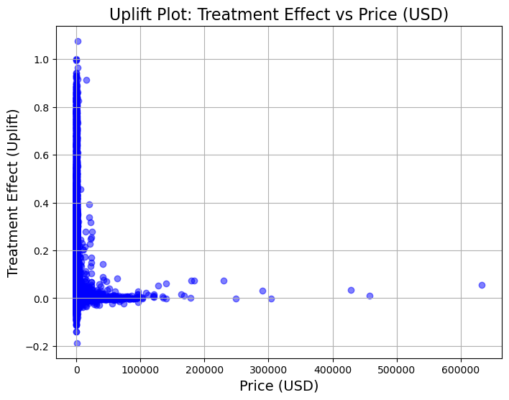
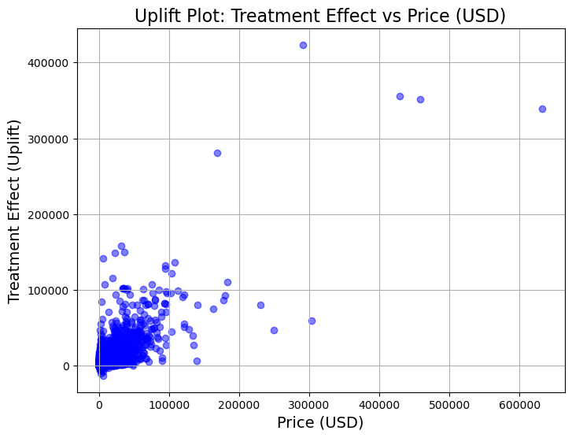
DoubleMLPLR Model
Outcome Model
Treatment Model
Left (High Uplift Segment): Certain customer groups respond positively to price increases.
Right (Low Uplift Segment): Most customers show minimal response, indicating limited elasticity.
Focus price increases on high uplift groups to maximize revenue.
Steep Decline: Clear differentiation in how customer segments react to price changes.
Implement dynamic pricing by targeting segments most likely to convert at higher prices.
Notes:
The two plots you provided visualize the treatment effects (uplift) estimated by the DoubleMLPLR model:
1. First Plot (ml_l - Outcome Model): This represents the predicted treatment effect of price on sales using the outcome model.
2. Second Plot (ml_m - Treatment Model): This represents the relationship between price and the controls—how the treatment (price) is influenced by the control variables.
✅ Interpretation of the First Plot (ml_l - Outcome Model):
1. High Treatment Effects at Low Prices:
There are many products with small prices where a small price increase has a large positive impact on sales.
This suggests that low-priced products are less sensitive to small price changes—possibly due to consumer willingness to buy low-cost items.
2. Diminishing Uplift at Higher Prices:
As price increases beyond $100,000, the uplift effect approaches zero.
This indicates that increasing price at higher levels no longer significantly affects the likelihood of a sale.
3. Negative Effects at Low Price Points:
Some points show negative treatment effects—implying that for some products, increasing price reduces sales.
This may reflect price-sensitive categories where buyers avoid small price increases.
✅ Interpretation of the Second Plot (ml_m - Treatment Model):
1. Higher Variability in Treatment Effects:
The treatment effects show large fluctuations as price increases, especially between $0 to $100,000.
This suggests the relationship between price and the control variables is not linear—certain control factors (like product category or season) cause large shifts in the estimated effect.
2. Extreme Values at High Prices:
Some treatment effects are disproportionately large (above 400,000)—indicating outliers where price changes lead to massive shifts in predicted outcomes.
This could be due to luxury goods or rare items that do not follow typical price-demand relationships.
Why Do the Two Plots Differ?
ml_l estimates how price influences sales after controlling for other variables (outcome model).
ml_m models how price is influenced by the control variables (treatment model).
Differences in their behavior arise because:
ml_l captures the direct causal effect of price on sales.
ml_m focuses on how price varies with confounding factors like product type, seasonality, and seller behavior.

Slide 17
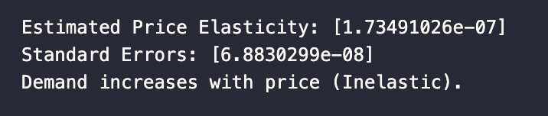
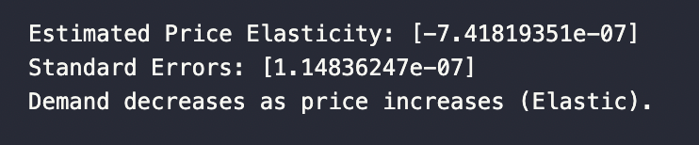
Price Elasticity Differences
Inelastic Demand for Listed Price (price_usd)
Elastic Demand for Seller Price (seller_price)
When the listed price is high, demand does not decrease significantly—or may even increase slightly. This suggests that customers are not highly sensitive to the official listed price. This makes sense because these items are mostly luxury brand items.
When the seller’s actual price increases, demand drops noticeably. Customers are price-sensitive when it comes to the amount they actually pay.

Slide 18
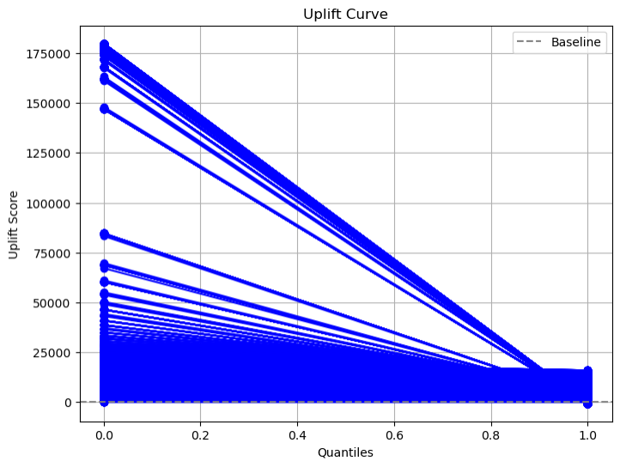
Uplift curve
Steep Decline from Left to Right:
The leftmost customers (top quantiles) have the highest uplift, meaning these groups respond well to higher prices.
As you move right, the effect weakens, and most customers show little to no uplift.
Large Positive Uplift in Early Quantiles:
Suggests there is a segment of the market where raising prices increases sales (e.g., luxury buyers or less price-sensitive consumers).
Baseline (Dashed Line at 0):If the uplift score is above the baseline, the treatment (high price) is beneficial.
Average Uplift Effect = 0.0789: On average, raising prices increases the likelihood of a sale by 7.89%.
Positive value confirms that your customer base exhibits inelastic demand overall.
Notes:
The uplift curve measures how much more likely a positive outcome (in your case, a sale) is due to the treatment (high price vs. low/medium price). It helps evaluate the causal effect of changing the price on customer behavior.
1. Segment-Specific Pricing: Focus on high uplift customers—these groups are willing to pay more without reducing purchase likelihood.
2. Low-Uplift Segments: Avoid increasing prices for low uplift or negative uplift customers—they are price-sensitive.

Slide 19

Business Insights
Premium Positioning
Price Optimization
Personalized Discounts
A/B Testing
Use higher listed prices for inelastic products to enhance prestige and drive profitability.
Apply a dynamic pricing model for seller prices to balance competitiveness with profitability.
Offer targeted incentives to capture elastic demand and boost conversions.
Continuously monitor and test pricing strategies to refine approaches and maximize both demand and revenue.

Slide 20
Seller Analysis
04

Slide 21

Classification

Slide 22
Feature Selection
Targets: Seller type
Predictors:
Price related: Discount rate; Buyers’ fee rate
Seller related: Seller pass rate; Seller badge level; Seller country; Avg like counts per product; Avg num listed products
Product related: Product condition; Product gender target; Shipment detail
Seller Group | Group Size
Regular | 106976
High Revenue | 79840

Slide 23
LightGBM
 | Precision | Recall | F1 - score
High Revenue | 0.82 | 0.77 | 0.80
Regular | 0.84 | 0.87 | 0.85
Accuracy | — | — | 0.83
Macro Avg | 0.83 | 0.82 | 0.82
Weighted Avg | 0.83 | 0.83 | 0.83

Slide 24
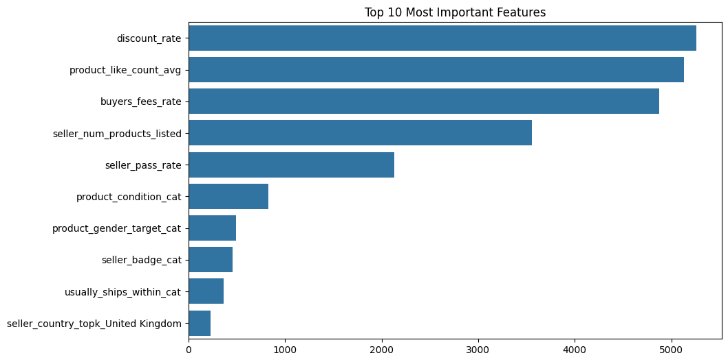
Feature Importance
Top Influencers:
Pricing strategy and customer engagement.
Moderate Influencers:
Seller reliability and inventory.
Less Influential Factors:
Products details and seller country features

Slide 25
Causal Inference

Slide 26
Uplift Random Forest
 | Uplift | Y( Seller Type) | T(Badge)
 | 21.18% | Regular | Common
 | 21.86% | Top | Common
 | 22.18% | Top | Advanced
 | 21.73% | Regular | Advanced
Y: Seller Type
Regular vs Top Seller
Treatment: Badge
Common vs Advanced

Slide 27
Business Overview

Slide 28
For Vestiaire Collective Platform
Fair Pricing Strategy
Encourage sellers to adopt fair pricing and build high-quality storefronts.
Badge System
Seller Support
Implement a tiered badge system that rewards quality and fair pricing.
Allocate additional resources to high-revenue potential sellers to drive platform growth
Interactive Atmosphere
Foster a dynamic community by encouraging customer-seller interactions like likes and comments.

Slide 29

Thank You!

Slide 30




Our team -Bit By Bit (Demand-Forecasting-Vestiaire)
Berly Brigith Biju
Chloe He
Samarth Annigeri
Yifei Liu
Berlyb
pity-piggy
Agent007repo
potential-rd

